Slide 1
Personalized Medicine: Redefining Cancer Treatment
SQLZW
Jiyuan Shen, Quincy Qu, Don Lee, Yaxuan Zhu, Yiming Wang
Notes:
\

Slide 2
Overview
Introduction
Motivation
Problem statement
Dataset
Evaluation
Approach
Feature extraction
Classification

Slide 3
Classifying Clinically Actionable Genetic Mutations
What is it?
Automatically classify genetic mutation based on clinical evidence.
Why important?
Thousands of genetic mutations! Manual work required for treatment.
How it possible?
Let’s see what we have...
Notes:
In short, we want to automatically classify genetic mutation based on clinical evidence.
A cancer tumor can have thousands of genetic mutation, some lead to tumor growing while others not. This makes personalized medicine for cancer treatment very difficult because experts have to read pages of clinical literature to classify each genetic mutation type and its effects. Although we already have advanced genetic testing technology, this process is very time consuming and low efficiency even for expert. So, it is of great importance if we are able to easily judge whether a genetic mutation is malignant without or with little human work.
How is it possible?
Luckily, we have a dataset of clinical records labelled by experts. And we know the knowledge of NLP and machine learning. In the next few minutes, I will show how it is possible and how we do it.

Slide 4
Expert-annotated Dataset
[Gene, Variation, Clinical evidence] -> type label (1 in 9 classes)
3000+ in training
900+ in test
Notes:
Let’s first look at the data.
The dataset consists of three parts, the genetic type, the variation, and the clinical evidence in English.
A label type is provided for each record in training set, each records belongs to 1 of the 9 classes.
In test set, there is no label.
There are plenty of things to discover in the dataset.

Slide 5
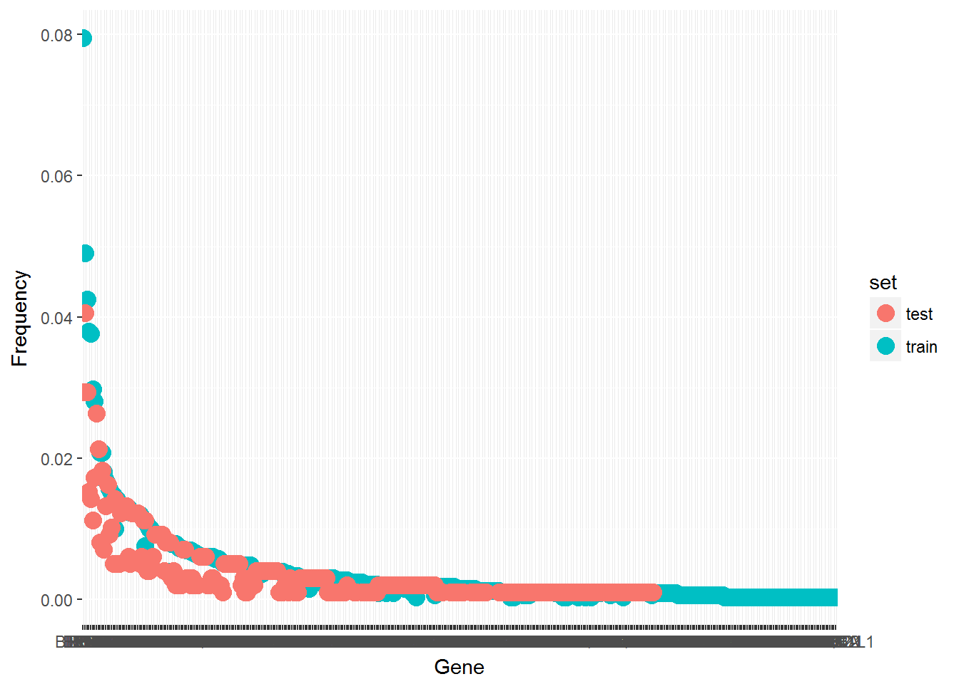
Notes:
This one, is the gene distribution in training set and test set. Most genes appear with very very little probability, we can see that from this long tailed distribution.
In training set, there are 264 genes,
the top 10 genes already covers more than 30% of the supports in training set.
And it is almost the same in test set.

Slide 6
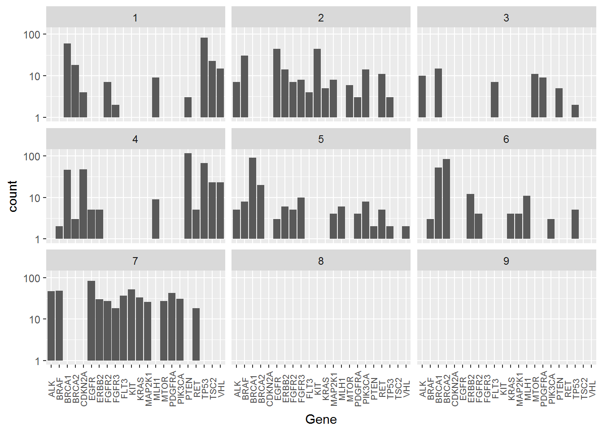
Notes:
And here, left hand side is the top frequent genes that classified into each class
On the right is the top variation type that classified into each class.
Together with the previous one, they show something interesting,
First, it is hard to classify only through gene or variation, and we have to consider their combination and use the clinical evidence.
Second, there are no popular genes that leads to class 8 and 9, which means that the data is greatly inballanced through the 9 classes.

Slide 7

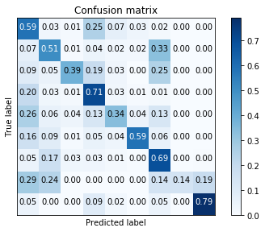
Evaluation
Log score (cross-entropy), on test set through submission, w/o label.
Ten-fold validation on training/validation set, w/ label, using:
Log score,
Confusion matrix,
Accuracy,
Normalized Mutual Information (NMI)
Notes:
Since we have a basic idea of the dataset, let’s discuss the evaluation.
The official evaluation is the log score, it computes cross entropy between the prediction and the ground truth. The lower the score, the better the prediction.
One point I have to mention is that, the dataset where the official score is computed, is unknown to us. We don’t have the label of test set so we get nothing except the late submission score. This is a problem when we want to evaluate our model. In this case, we come up with these metrics using ten-fold validation during developing phase. (click)
This is one Confusion matrix of our experiment, we visualize it in this way.

Slide 8
Approach: Feature extraction
Concatenate features of three parts of data
Gene: one-hot-encoding
Variation: one-hot-encoding
Clinical Evidence (Text): NLP models (Bag of words, TF-IDF, word-embedding)
But...
Feature length?
Model selection?
Use background knowledge?
Notes:
The primary idea is to concatenate features of 3 parts of data together.
Concretely, we use one-hot encoding for gene and variation,
And extract features from clinical evidence using NLP models, including Bag of words, TF-IDF and word embedding.
But, there are so many questions to be solved.
How do we determine the length of the feature?
How do we select the NLP models?
And inspired by our presented paper, the author take use of social science theory in their study, what if we somehow take use of some background medical theory in this problem?
I’m not going to discuss these in this presentation, but we tackled with these problems during the experiment and more details will be covered in the report.

Slide 9
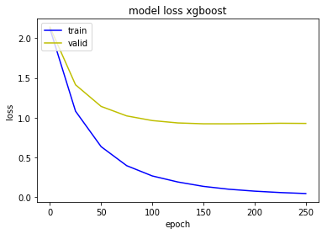
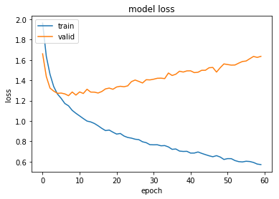
Approach: Multi-class Classification
Neural Network, SVM, Naive Bayes, decision tree…
Tons of them…
How do we choose?
Xgboost has the best performance.
Results of {Xgboost, Neural Network, Naive Bayes, GBDT} will be showed in the report.
Notes:
Here the task is to classify a feature vector into a class.
in our view, the primary concern is to deal with overfitting problem, since we only have 3K training data.
(click)
This is a training curve when we tried to fit a shallow neural network as a baseline. It is an indication that we have to find other models that work well with small dataset and avoid overfitting.
The result is good with xgboost, and we will explain it in detail in the report, together with the comparison among other models.
So far, we ranked among 140 / 1400 teams in this contest, which is top 10%.

Slide 10
Thank you!
https://github.com/AlvinZhuyx/Personalized-Medicine-Redefining-Cancer-Treatment

